Slide 1
Modeling Covid-19
SIR Model
Mehdy Hounkonnou and Pol Labarbarie

Slide 2
The SIR Model
Aim : Estimate how the number of individuals in each compartment grows
N = S(t) + I(t) + R(t)
N : Number of people in the population
S : susceptible people
I : Infected people
R: Removed people

Slide 3
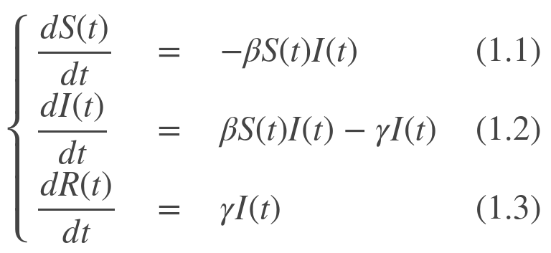
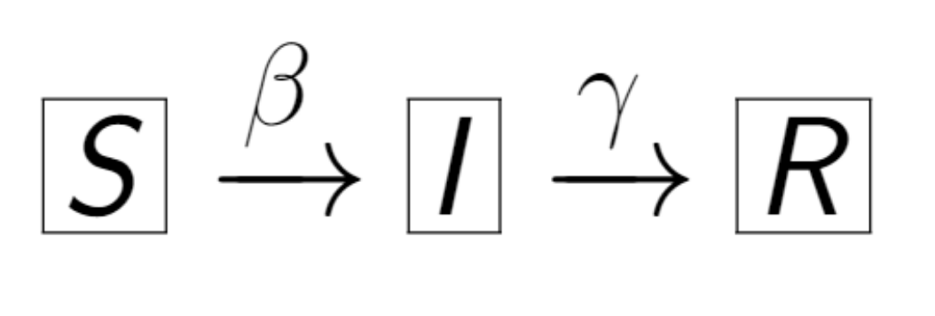
The equations

Slide 4
Euler’s method
General case : y’(t) = f(t,y(t)) , y(t₀) = y₀
h : the size of every step
and set t_{n} = t₀ + nh
Now one step of the Euler’s method is : y_{n+1} = y_{n} + hf(t_{n},y_{n})
Applied here : S_{n+1} = S_{n} - ꞵS_{n}I_{n}

Slide 5
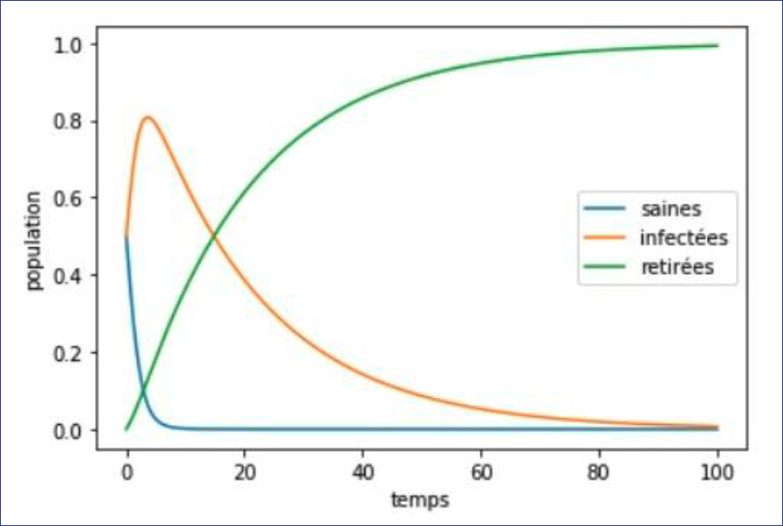
SIR model prediction for transmission rate = 0.8 and healing rate = 0.05
Source : images.math.cnrs.fr

Slide 6
DECISION MAKING
How could we see the effects of decisions under the evolution of the epidemic ?

Slide 7
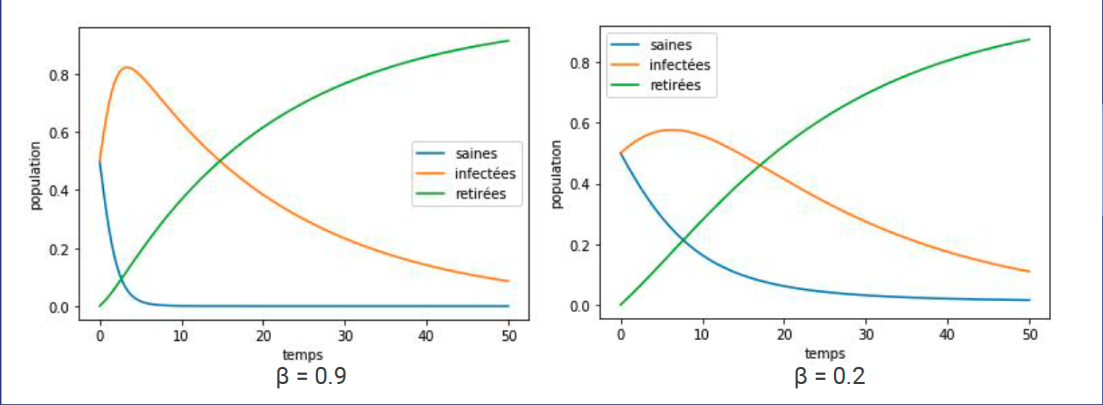
Changing the transmission rate

Slide 8
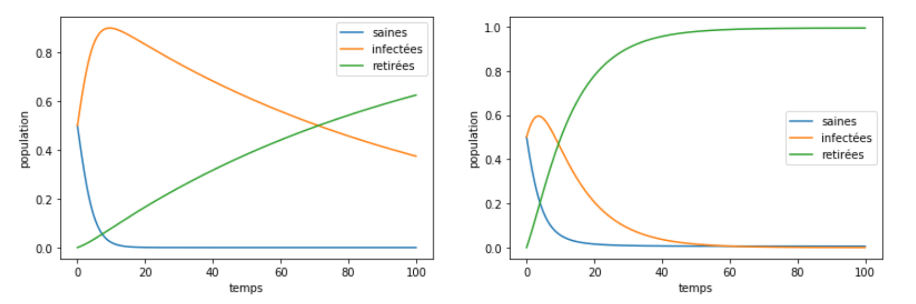


Changing the healing rate

Slide 9
SIR model’s limits

Slide 10
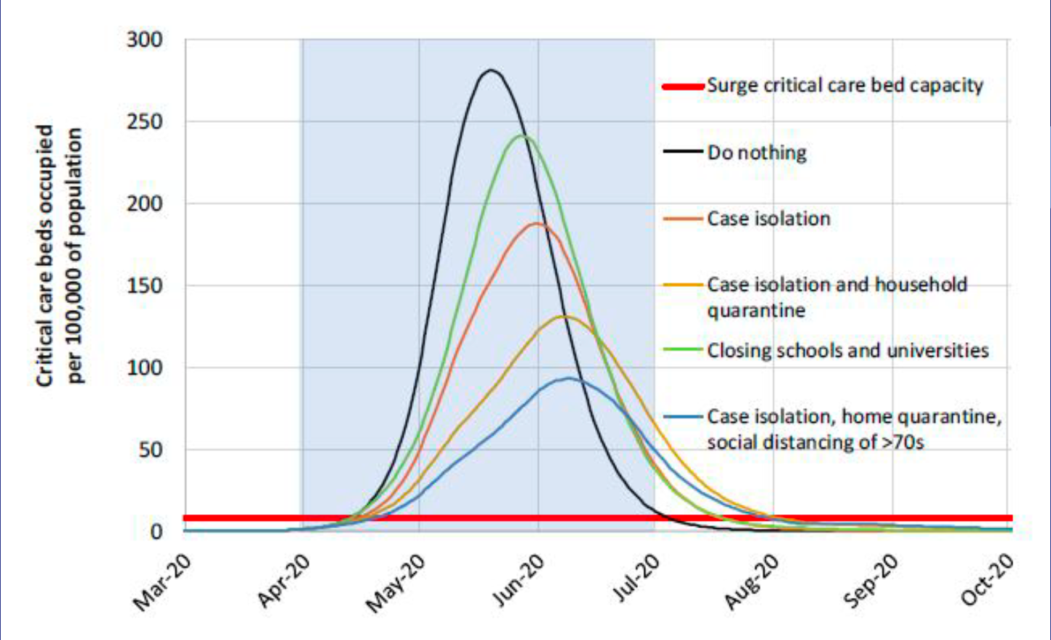

Slide 11
THANK YOU FOR YOUR ATTENTION
https://images.math.cnrs.fr/Modelisation-d-une-epidemie-partie-1.html#nb17
https://www.imperial.ac.uk/media/imperial-college/medicine/sph/ide/gida-fellowships/Imperial-College-COVID19-NPI-modelling-16-03-2020.pdf

